Slide 1

Medulance
ASSISTING LIVES

Slide 2
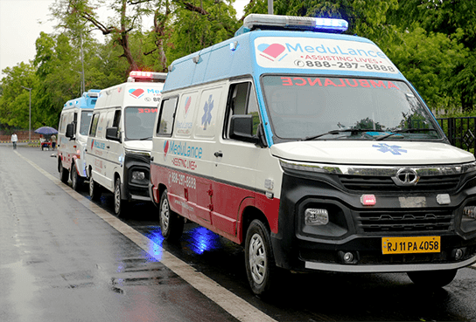
What is
Medulance?
India's first, GPS based technology platform for fast and reliable first point medical attention. With an increasing emphasis on promoting independent living today, having access to the nearest ambulance to you can provide much needed peace of mind in a worst-case scenario.

Slide 3
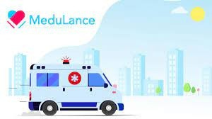
HISTORY/IDEA
Emergency response is the most critical to the lifeline of any country. Medulance wants to inspire breakthroughs in the way India looks at ambulances and first-point medical attention and to touch lives. Medulance was started in the year 2017 to make finding an ambulance as easy as finding food or taxis these days to assist lives. Medulance is an integrated emergency response support provider, ambulance booking and tracking system designed to provide first-point medical attention.

Slide 4
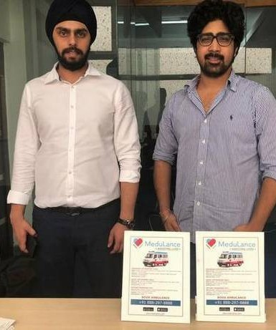
Founders
Pranav Bajaj, Co-founder, Medulance Healthcare drives partner acquisition and growth at Medulance. Born and raised in Delhi, an alumni of Modern School, Pranav pursued his graduation in Finance from Shaheed Sukhdev College of Business Studies.
He also leverages his marketing lead experience with ThatsRealty, a real estate start-up, as well as some quality time in Strategy and Operations consulting at Deloitte, to add value to his role at Medulance.
A Computer Science Engineer, Ravjot is a resident of Delhi with a Certificate of Entrepreneurship from IIM, Kashipur. Always an innovative thinker with an itch to do things differently, Ravjot had been working on location-based technology, emergency technology ever since college days.Ravjot brings in new ideas and technological integrations while directing the operational aspects to ensure effective working at Medulance.

Slide 5

Problems Faced
The major issues faced are -
Severe lack of awareness and facility of first aid communication Inability of a person to have a top of mind recall of emergency numbers
High response time
Large number of calls being missed
The Emergency & Ambulatory services sector is unorganised Lack of awareness coupled with the lack of technology
No prominent national entity in emergency response.

Slide 6

Solutions/Services
End to end emergency response service GPS enabled high quality ambulances Emergency Management Technology Trained Drivers and certified Paramedics
Covering 22 cities in India (All metros & Major tier 2 cities)
Dedicated Helpline Number

Slide 7

Growth rate
The startup has registered a growth of 300% in 2019-2021. It further grew 2x the next year, Pranav Bajaj, co-founder of Medulance, said in a conversation with Business Insider India.
Medulance runs a fleet of 5800 ambulances across 22 cities and the aggregator aims to increase the fleet to approx. 7000 by the end of 2021 and 12000 by the end of 2025. Currently, the paramedical services startup takes more than 400 calls daily and services 95 per cent of these distress calls with its GPS-enabled ambulances with a dispatch time of just 3-4 minutes.
During the second wave of the pandemic, this number went as high as 1400+ calls per day.

Slide 8

Happy Customers
The services were easy to connect to and incredibly quick. When I called them, they inquired about my needs and dispatched an ambulance with all the necessary equipment. Overall, it was a great service.
The services were very prompt, and the staff was very friendly and co- operative. The Ambulance is very well equipped and very hygienic.
The driver showed concern by waiting after the drop, to make sure the patient's home oxygen concentrator was working properly. The entire crew was very helpful.
- Kaushlaya, Lucknow
- Jitendra Bajaj, Jaipur
- Greenidge Fernandes, Delhi

Slide 9

COMPETITORS

Slide 11


Over the next 2-3 years, as the demand for emergency response systems increases, Medulance is planning to expand its fleet to over 20,000 ambulances in 1,000 cities.
The end goal is to have the maximum number of ambulances
per pin code to ensure faster response time.
In the next 2-3 years, there is a plan to actively grow hospital partnerships by providing technology for quality care through our 5G ambulance.
FUTURE PLANS

Slide 12
Thank You

